Slide 1
Multi-Dimensional Arrays
Python – Lists of Lists

Slide 2

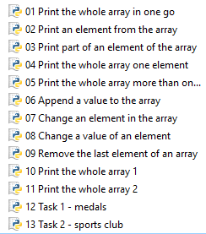
Instructions
For each slide there is a Python program
Using the screen recording feature within powerpoint, record the program running and explain what is happening and when you might use it.
The first one has been done for you.

Slide 3
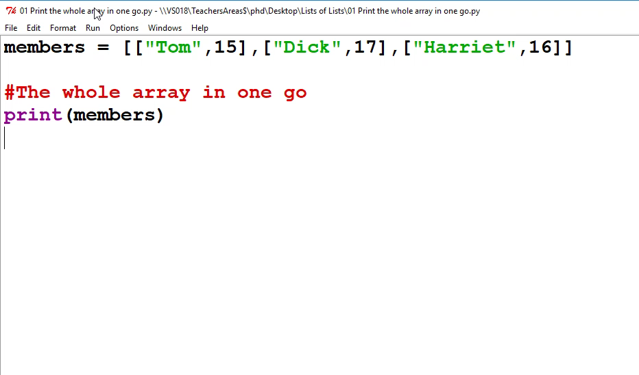
01 Print the whole array in one go

Slide 4
02 Print an element from the array

Slide 5
03 Print part of an element of the array

Slide 6
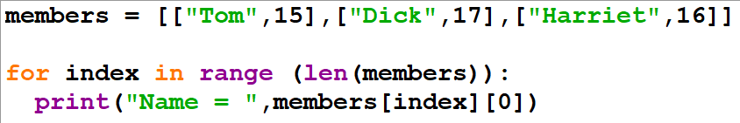
04 Print the whole array one element

Slide 7
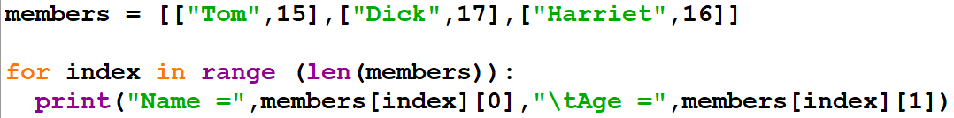
05 Print the whole array more than one element

Slide 8
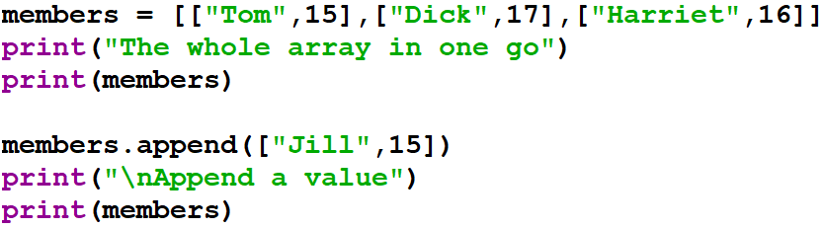
06 Append a value to the array

Slide 9
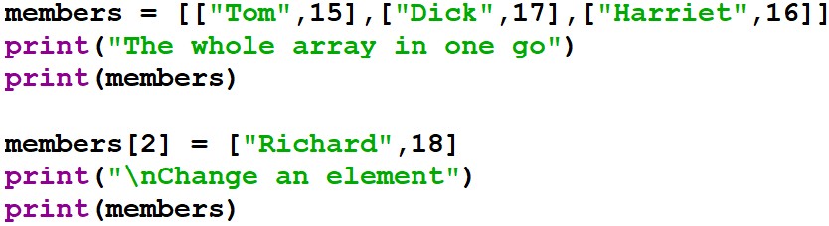
07 Change an element in the array

Slide 10
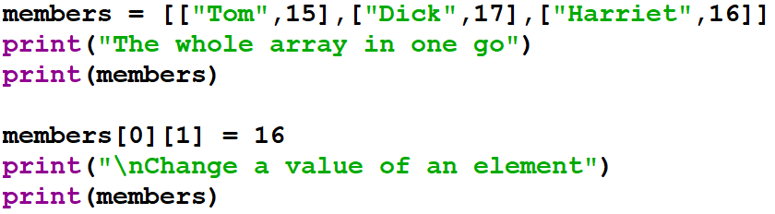
08 Change a value of an element

Slide 11
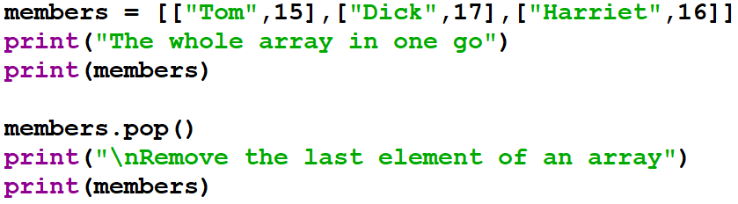
09 Remove the last element of an array

Slide 12
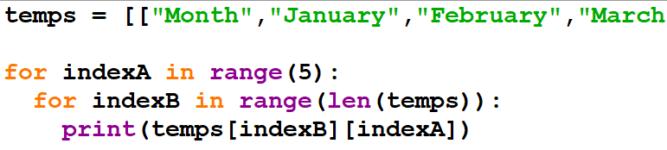
10 Print the whole array 1

Slide 13
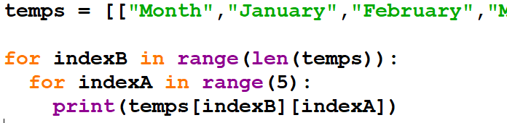
11 Print the whole array 2

Slide 14
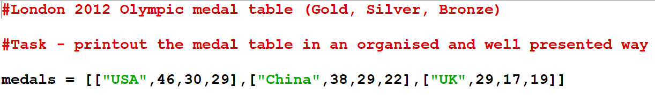
12 Task 1 - Medals

Slide 15
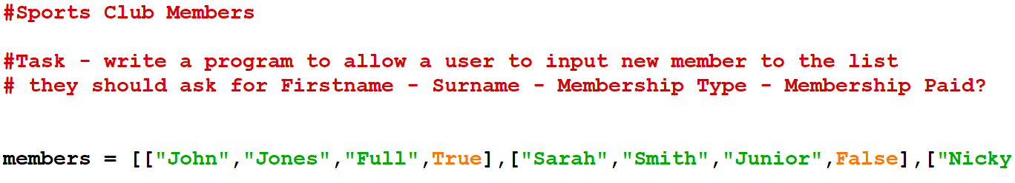
13 Task 2 – Sports Club

